Slide 1
Project Completion Management in Construction Management
Han Mei

Slide 2
Motivation
Completion date is very important in construction project;
Past due will cause the overall cost beyond budget;
And also will cause some other risks, such as overtime working, occupation injury and so on;
Monte Carlo simulation is needed to help us do the simulation.

Slide 3
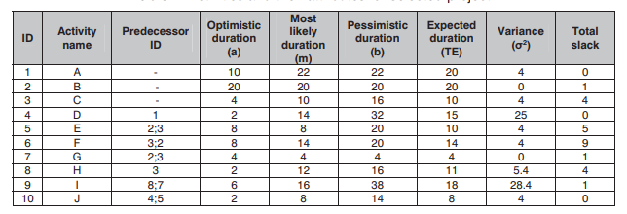
Method for simulation

Slide 4
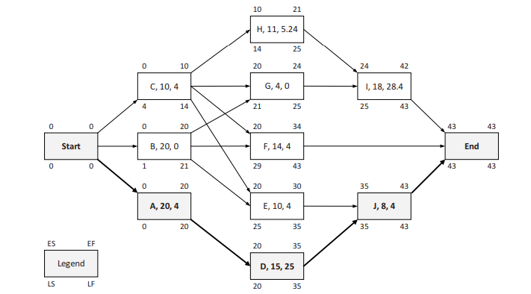
Activity-on-node

